Slide 1
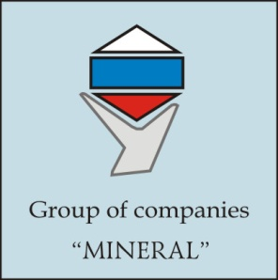
Hydrothermal hydroxyapatite
Mineral Ltd.
Address: 1, Institutskaya str., Alexandrov, Vladimir Region
601650 Russia

Slide 2
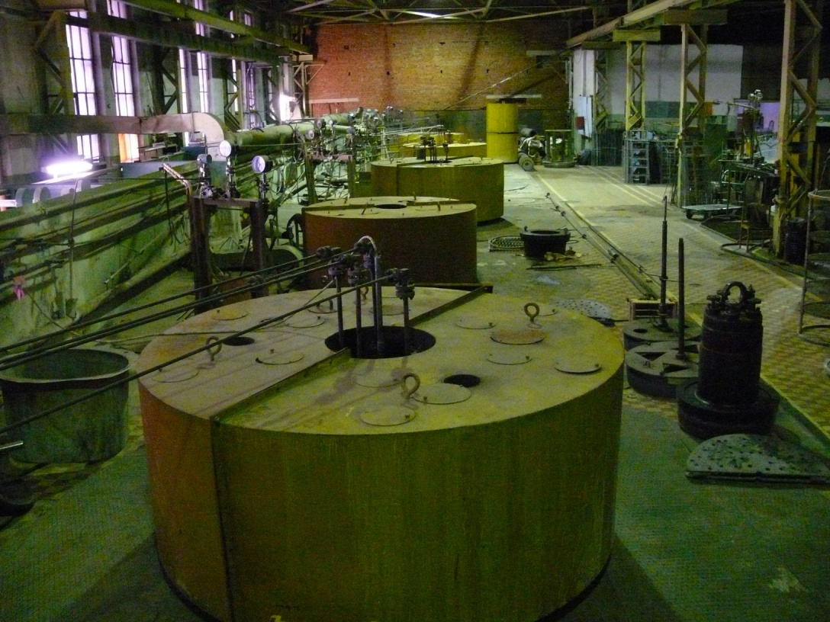
Main figures
Employee: 125 including
19 Ph.D.
Total facilities area: 50 000 sq.m.

Slide 3
Structure of Sales

Slide 4
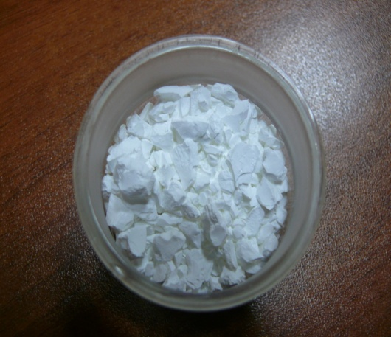
Hydroxyapatite
Ca₁₀(PO₄)₆(OH)₂
Biocompatible phosphate with structure of bone apatite
Material of implants
Material of face lifting fillers in cosmetology
Supplement to the food
Sorbent

Slide 5
Face lifting by HAP
Radiesse – over 5 millions syringes sold
Price of one syringe 400 USD-1500 USD for 1.5 ml of mixture HAP+gel
HAP stimulate formation of collagen on its surface
HAP have good crystal lattice match with collagen
Duration of one syringe work: up to 24 months

Slide 6
Methods of hydroxyapatite synthesis and challenges
Solid state synthesis -too big grains and not uniform properties of particles because of slow diffusion in solid state;
Aqueous precipitation- low degree of crystallinity, other phosphate phases can appear;
Hydrothermal- high and low degree of crystallinity achievable, single phase of HAP, require special autoclave equipment;
Sol-gel- same issues as in aqueous precipitation;
Self-propogation combustion- low cristallinity after calcination

Slide 7
Importance of crystallinity degree
High crystallinity degree of HAP possible to be achieved using hydrothermal method only because temperature of synthesis must be over 250 centigrade in aqueous solution
High crystallinity degree HAP is best substrate for collagen formation because lattice match
Resorbability of high crystallinity degree HAP could be adjusted by Ca/P ratio to desired value

Slide 8
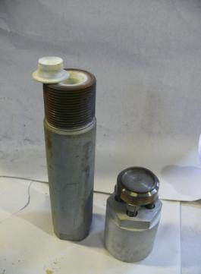
Hydrothermal method challenges
Easy to produce and replace fluroplastic liner for small autoclave
Autoclave 0.5 liter with 0.3 liter fixed liner can be easy turned, inserted in machine for lining installation and replacement

Slide 9
But how to do with big autoclave needed for mass production??

Slide 10
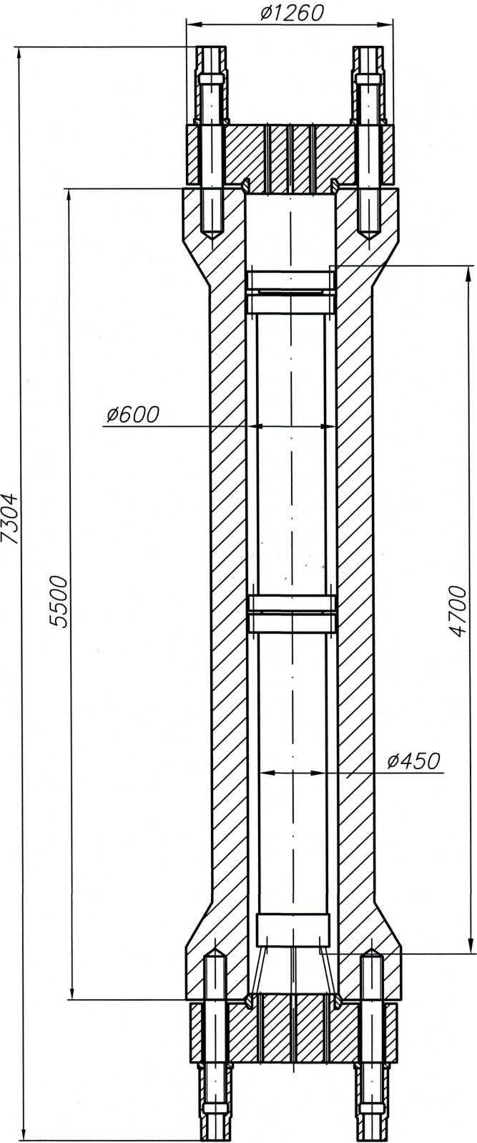
Mineral Ltd. have industrial proven solution: floating liner
Example: 525 liter floating liner inside 1500 liter autoclave;
“Floating “ mean that liner is not fixed to the inner wall autoclave but free stand on support; liner walls are under action of pressure created by water inside liner and outside liner.

Slide 11
Features of floating liner
Liner can be easy replaced or repaired without demand of moving autoclave because liner free stand on support surrounded by water;
It is possible to maintain high pressure inside liner with “thin” liner walls due to compensation by outside pressure dependent of filling ratio of external autoclave with water;
Industrial floating liners have been successfully used by us for industrial zincite and calcite hydrothermal growth.

Slide 12
Features for the project
Biocompatible undoped nano HAP powder with high crystallinity degree Ca/P=1.67 are used for granules manufacturing to provide longest time of resorbability;
Spherical shape of granules are optimum for syringe

Slide 13
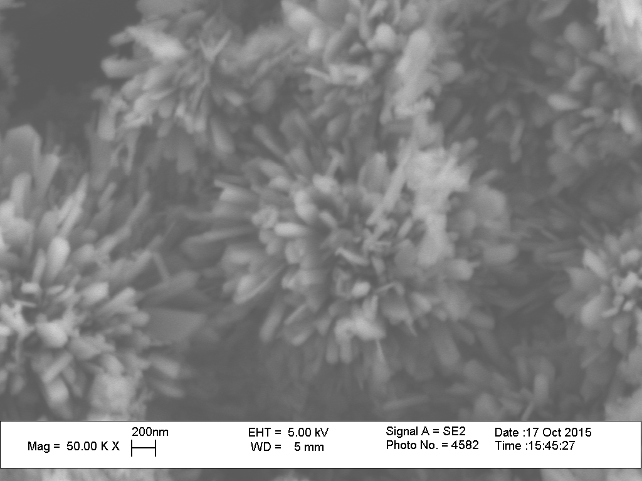
SEM for High Crystallinity Degree HAP
T=280 centigrade, dT= 0 centigrade, Duration =10 hours

Slide 14
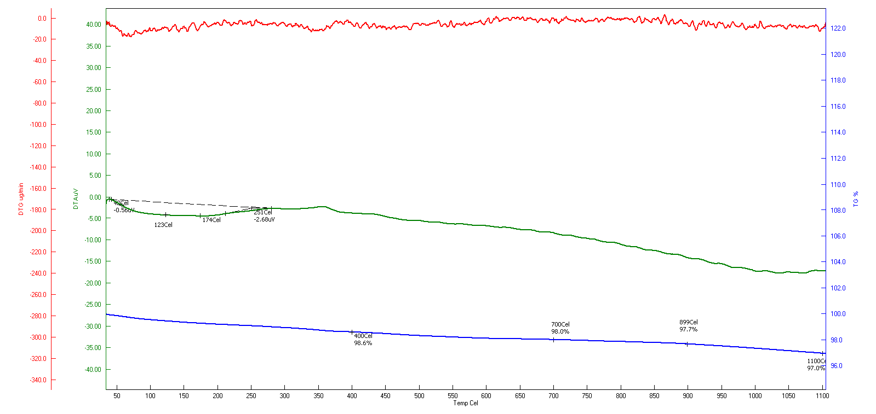
TGA, DTA for High Crystallinity Degree HAP
T=280 centigrade, dT= 0 centigrade, Duration =10 hours

Slide 15
XRD for High Crystallinity Degree HAP
T=280 centigrade, dT= 0 centigrade, Duration =10 hours

Slide 16
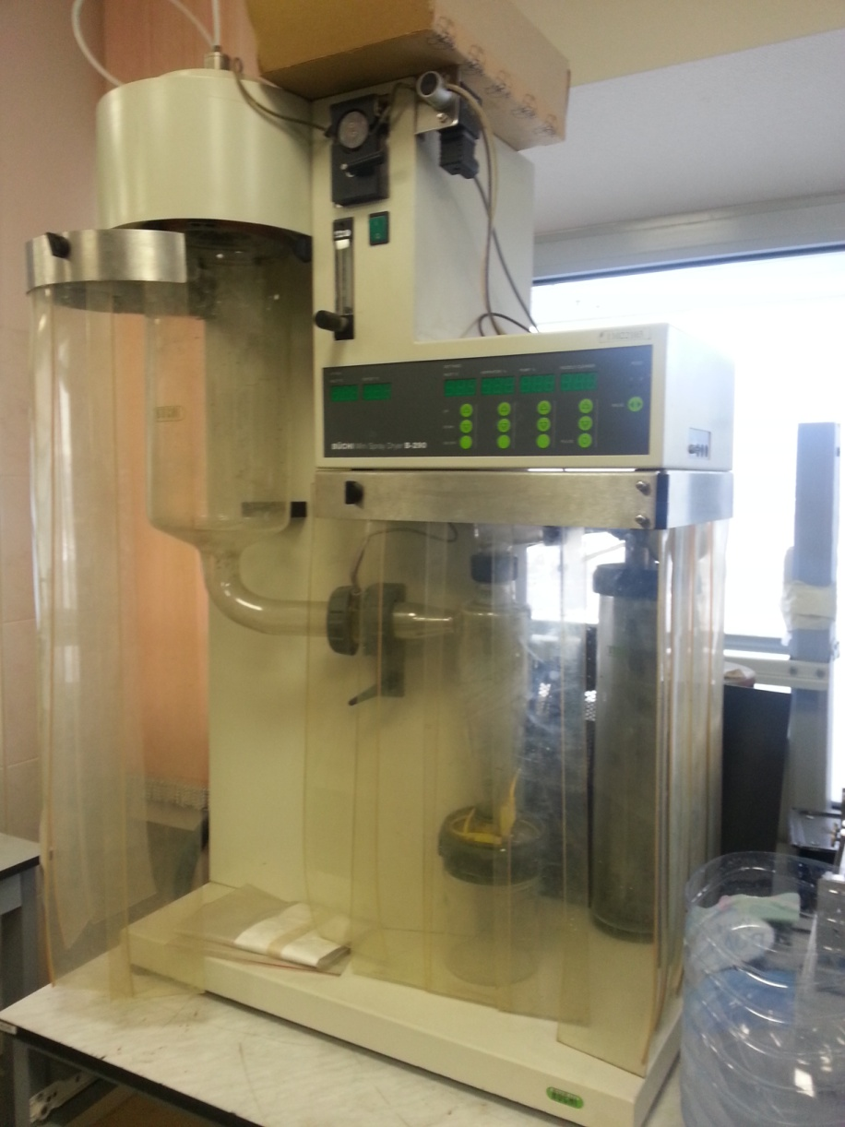
Spray dryer

Slide 17
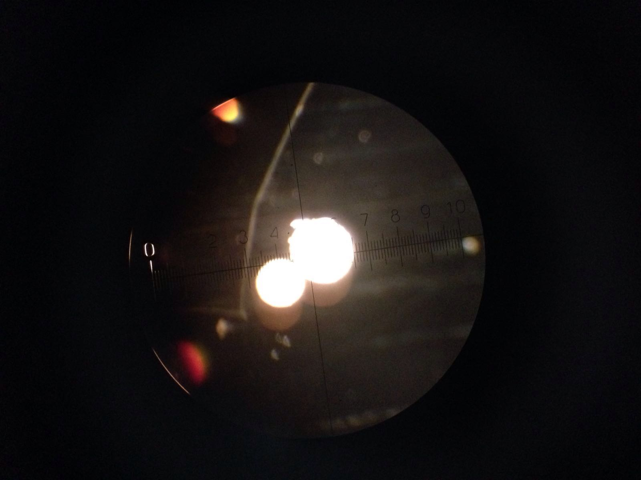
Spherical granules

Slide 18
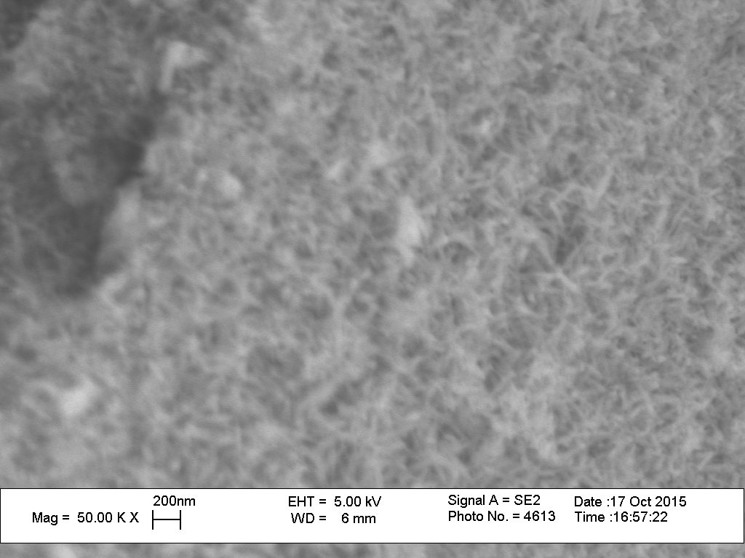
SEM for Low Crystallinity Degree HAP
T=30 centigrade, dT= 0 centigrade, Duration =1 day

Slide 19
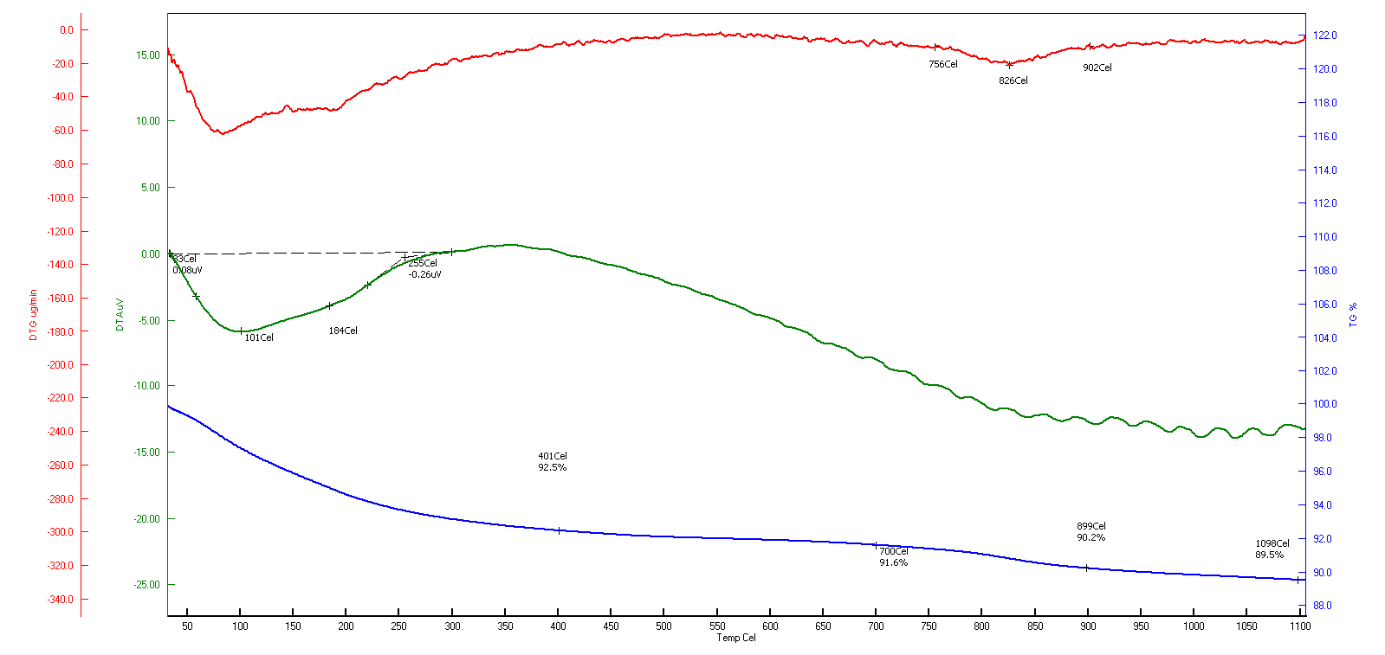
TGA, DTA for Low Crystallinity Degree HAP
T=30 centigrade, dT= 0 centigrade, Duration =1 day

Slide 20
XRD for Low Crystallinity Degree HAP
T=30 centigrade, dT= 0 centigrade, Duration =1 day

Slide 21
UV blocking creme with HAP
Mineral developed HAP: Fe3+
Can be applied for UV blocking and wrinkles decrease

Slide 22
THANK YOU

